Slide 1
Electronic Library
Code First Girls
Elisa Ferreira Malva

Slide 2
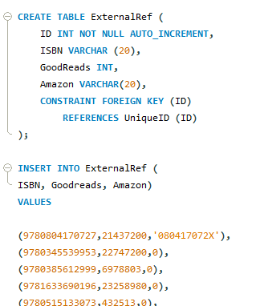
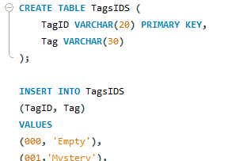
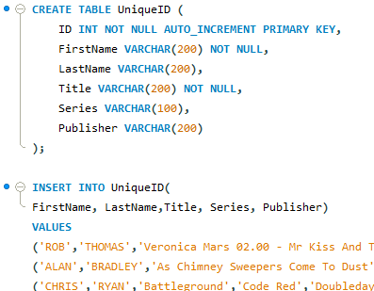
Create a Relational DB with minimum five tables
Table 1- Main book data
Table 2 – Book References
Table 3 – Tags Index

Slide 3
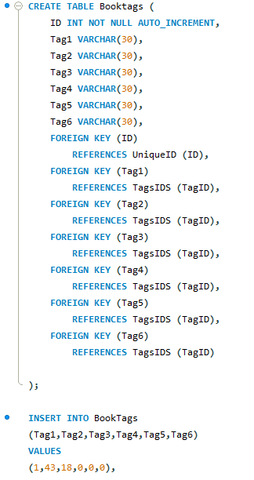
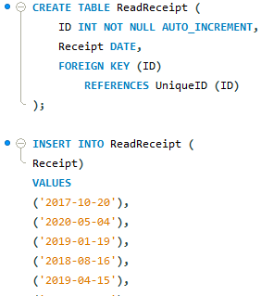
Table 4 – Book tags
Table 5 – When was last Read

Slide 4
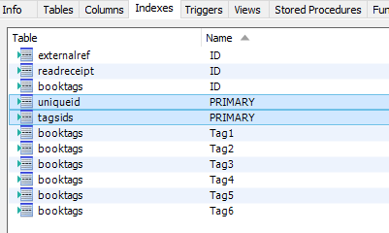
Set Primary and Foreign Key Constraints to create relationships between tables

Slide 5
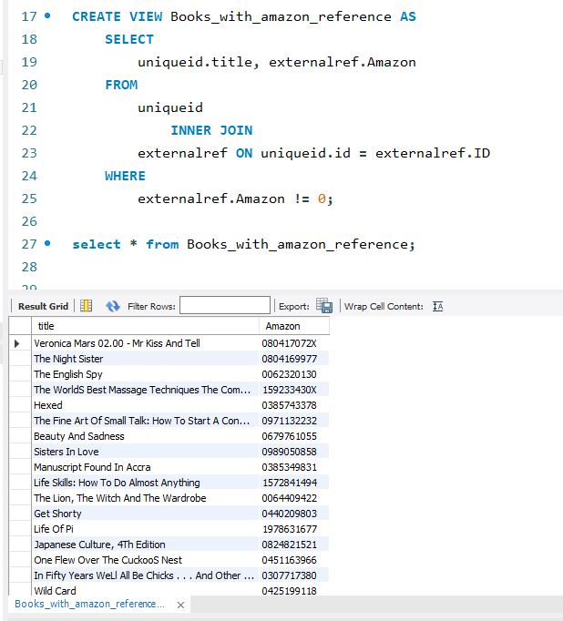
Using any type of the joins create a view that combines multiple tables in a logical way
Joined both ‘UniqueId’ and ‘ExternalRef’ tables by the ID to extract the data set that already had an Amazon number

Slide 6
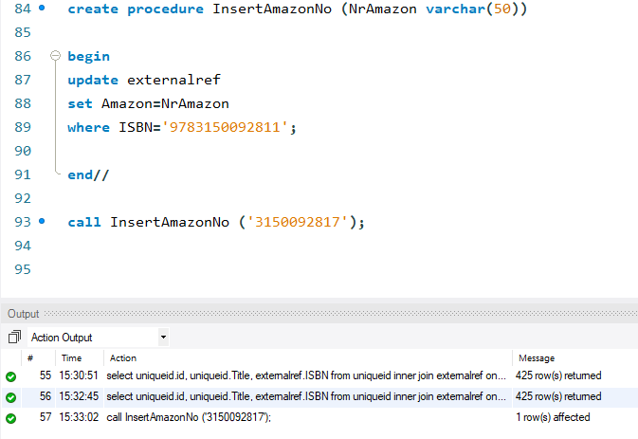
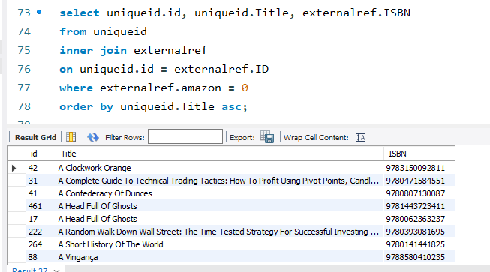
In your database, create a stored function that can be applied to a query in your DB
Anchor Query

Slide 7
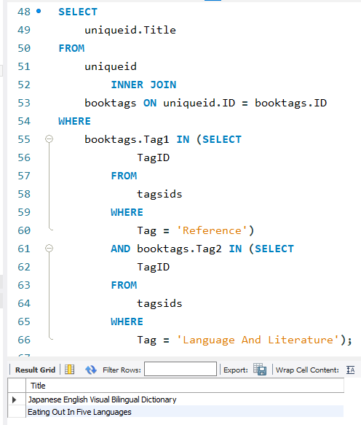
Prepare an example query with a subquery to demonstrate how to extract data from your DB for analysis
Searched the book titles that had been classified as a ‘Reference’ book as first tag and ‘Language and Literature’ as a second tag.
Resulting on two different titles with both characteristics

Slide 8
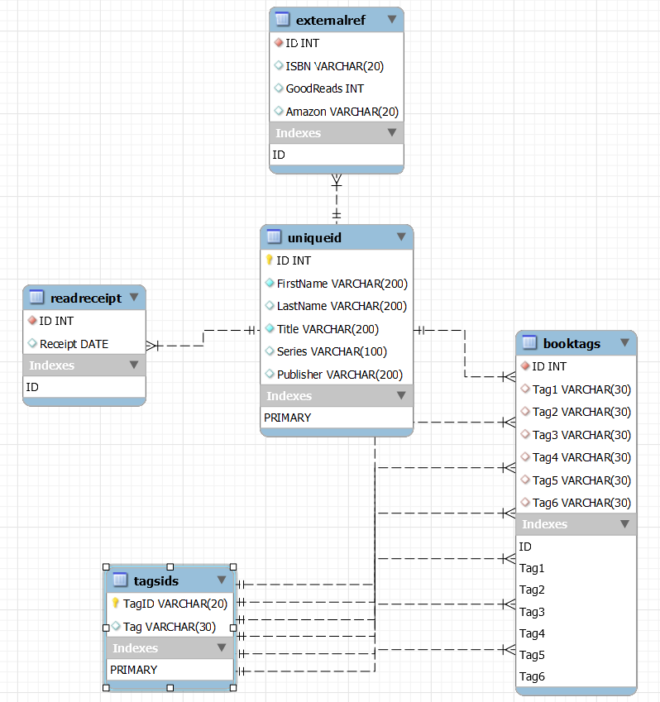
Create DB diagram where all table relations are shown

Slide 9
Now to MySQL for demos

